Slide 1
Job Specification / Interview Tips
By Joe Kirkup and Cameron Hillier-Nutley

Slide 2
Job Specification

Slide 3
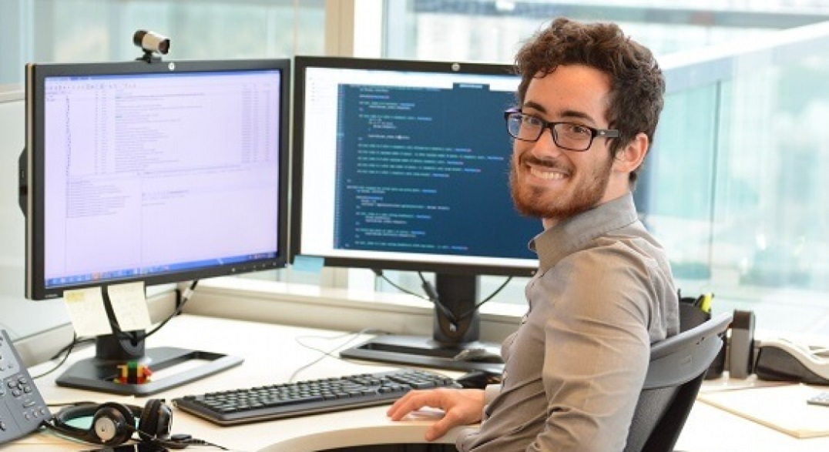
Software Developer
Salary: £20,000 - £70,000 average per year
Hours: 37 – 40 a week
Design, build and test computer programs
Can be done for business, education and leisure activities or really any subject –
programming is everywhere

Slide 4

What do you need to get the job?
Common to get this job though an apprenticeship
Software Development or Business degrees at universities
Degrees in subjects such as:
Computer Science
Software Development
Mathematics
Statistics
Business

Slide 5
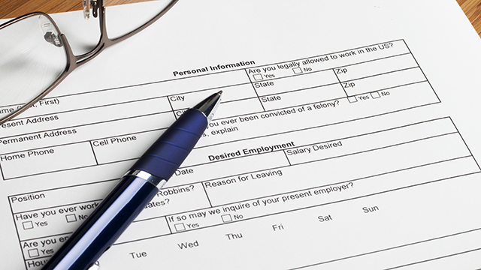
Is this the job for you?
You should:
Have an interest in programming
Have good IT competence
Be business savvy
Understand development processes
Have mathematics skills
Be able to work under pressure

Slide 6
Interview Tips

Slide 7

During an interview
What do you talk about?
Skills and abilities
The ideal work environment
Your goals

Slide 8

How to answer questions
Good questions
Bad questions
Bad question:
Caution
Make it good
Good question:
Confidence
Assurance
Proof if possible

Slide 9

What questions do you ask?
“How would you describe the responsibilities of the position?”
“How would you describe a typical day in the position?”
“When can I expect to hear from you?”
“What are the biggest challenges of the job?”

Slide 10

How to avoid saying stupid stuff
Always be prepared
Have an answer to everything
Appear self-motivated
Show enthusiasm
Pay attention

Slide 11
Do not say these stupid things
“What does you company do?”
“What will my salary be?”
“Will I have to work long hours?”
“How soon will I be able to take a holiday?”
“How quickly will I get a promotion?”
“Will I have to take a drug test?”
“Do you want to go for a coffee after this?”

